Slide 1
CGKG

Slide 2
ACADEMIC SESSION 2021-22
SESSION STARTED W.E.F. 01 APR 21 WITH A STRENGTH OF 141 STUDENTS
ONLINE CLASSES BEING CONDUCTED USING VIRTUAL PLATFORMS LIKE GOOGLE MEET/ WHATS APP VIEW ONGOING PANDEMIC SCENARIO
INITIATION OF LIVE DIGITAL CELEBRATIONS/ ACTIVITIES VIRTUALLY USING GOOGLE MEET BY SHARING A COMMON LINK
RECRUITMENT OF A TRAINED TEACHER CARRIED OUT DURING AUG 21
ADMISSION OF A SPECIAL CHILD (DOWN SYNDROME) IN CLASS NURSERY
RETAINING WALL AND HARD STANDING/ SAND CUSHIONING OF PLAY AREA WORK COMPLETED
PROCUREMENT OF NEW HAND SANITIZING MACHINE (TOUCH LESS) CARRIED OUT
PROVISIONING OF DRAINAGE SYSTEM MADE IN CHILDREN PLAY AREA

Slide 3
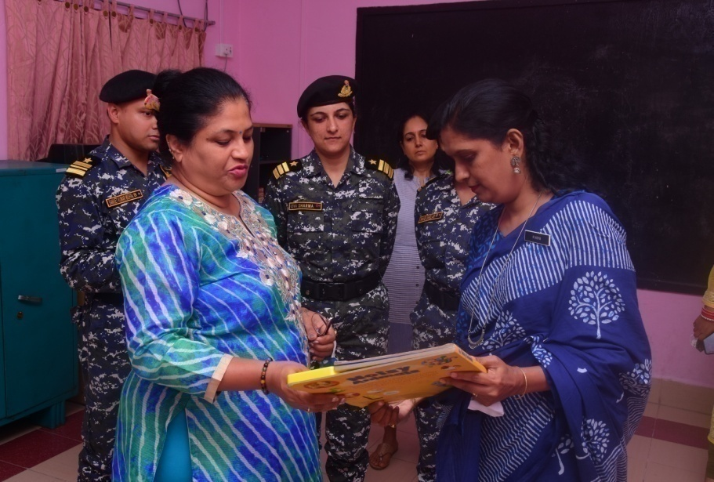
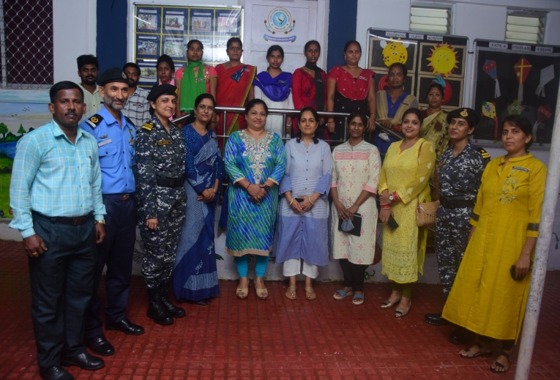
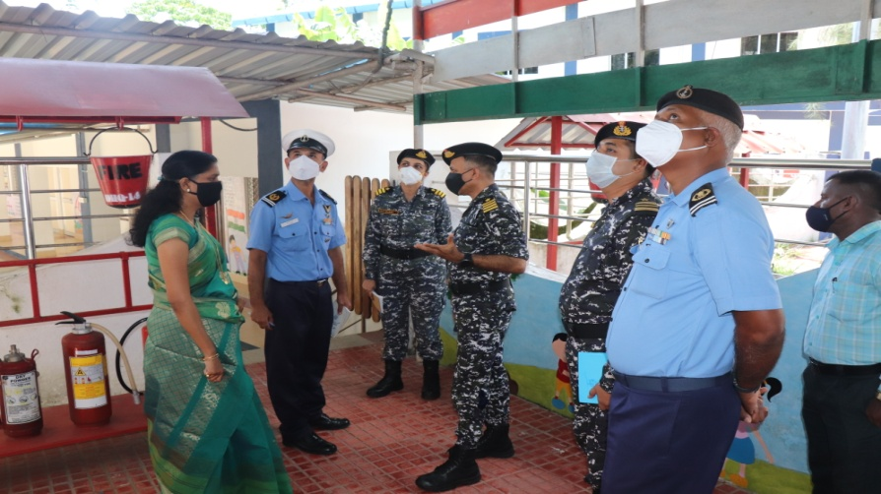
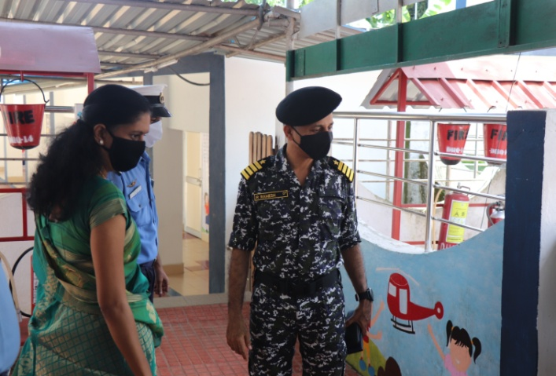
GALLERY
PRESIDENT TATRAKSHIKA (A&N) VISIT
CHAIRMAN VISIT

Slide 4
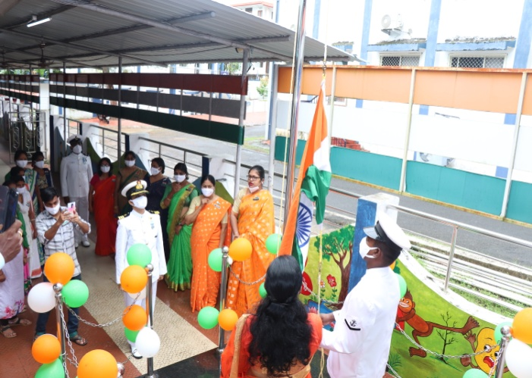
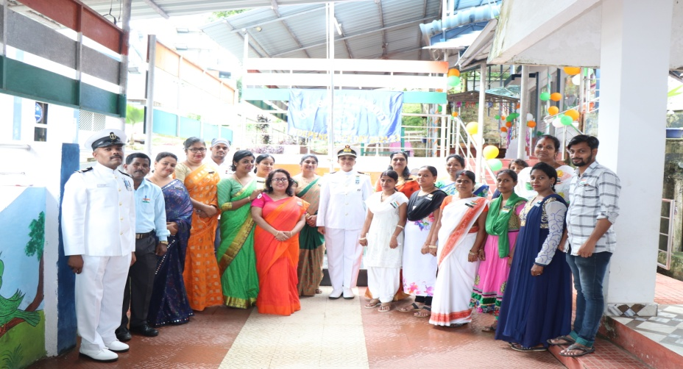
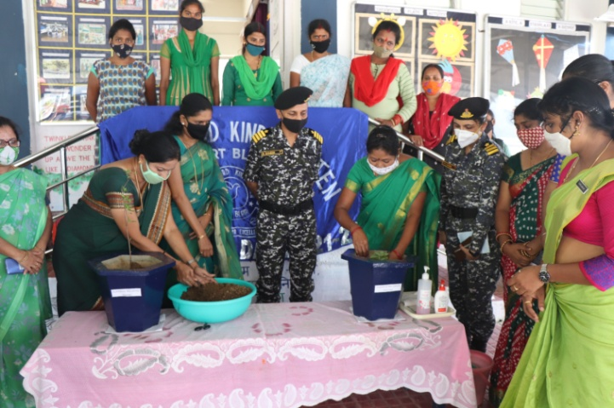
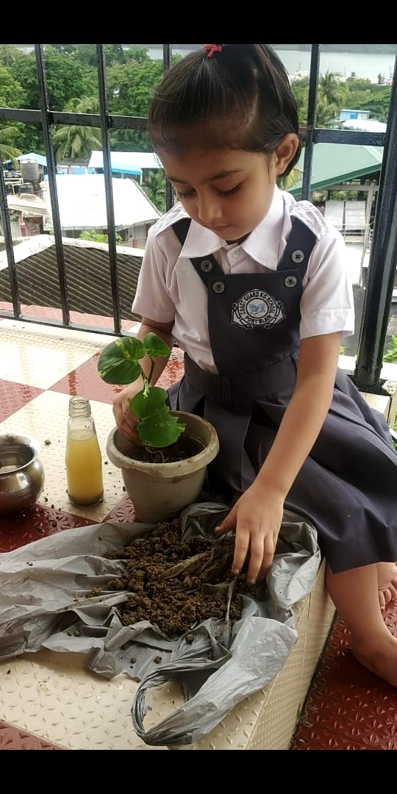
GALLERY
INDEPENDENCE DAY CELEBRATION
PLANTATION DAY

Slide 5
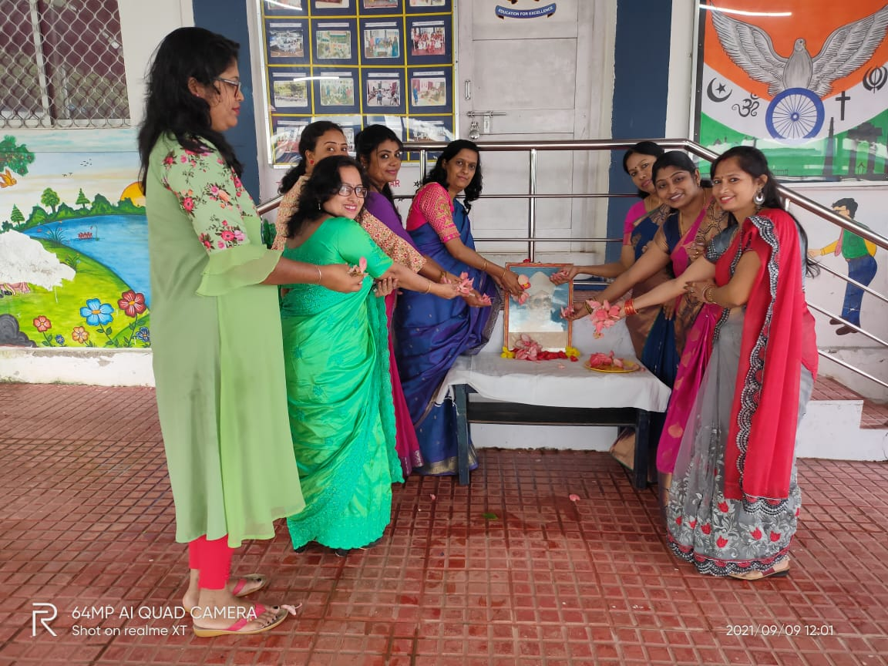
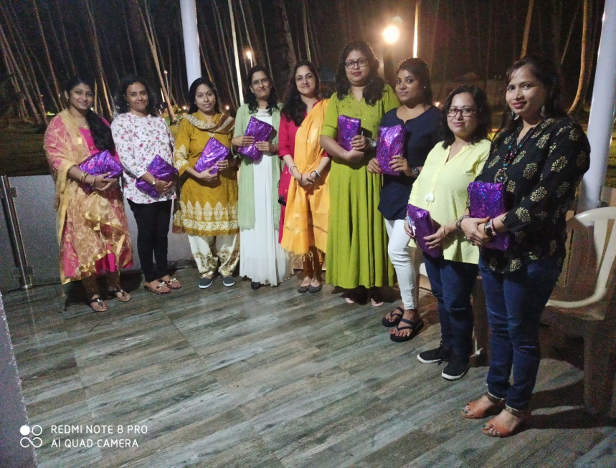
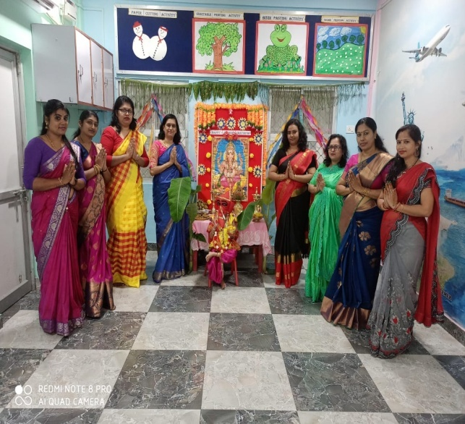
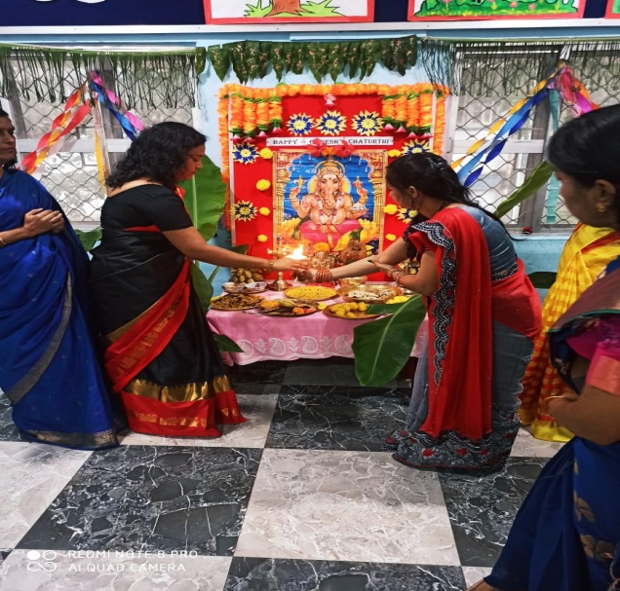
GALLERY
TEACHER’S DAY
GANESH CHATURTHI CELEBRATION

Slide 6
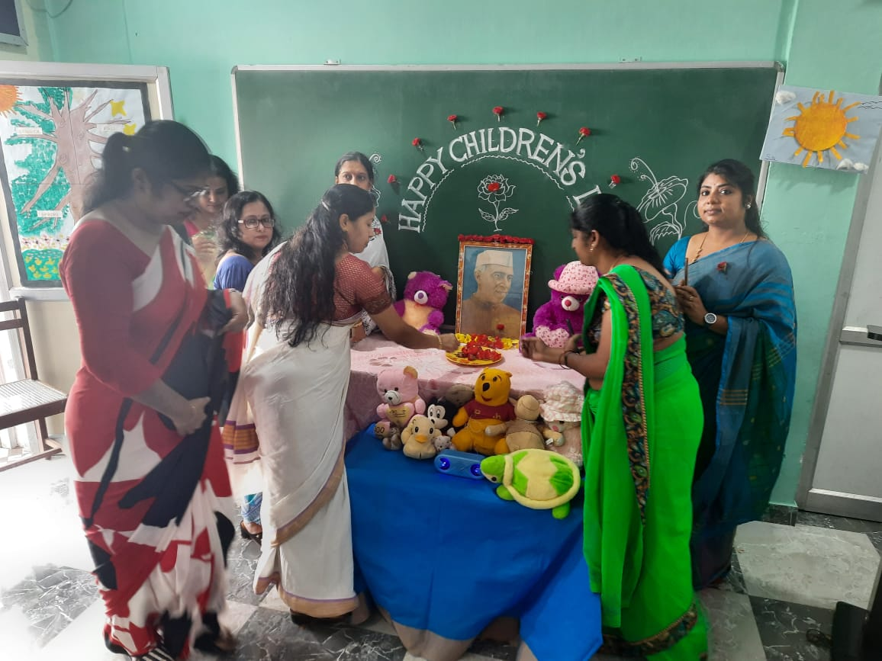
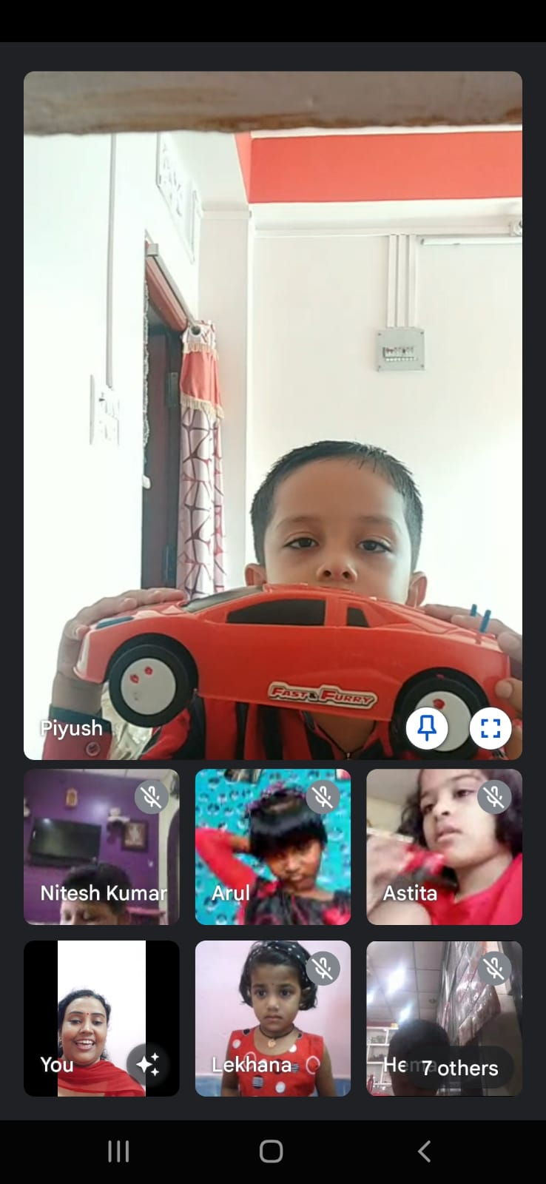
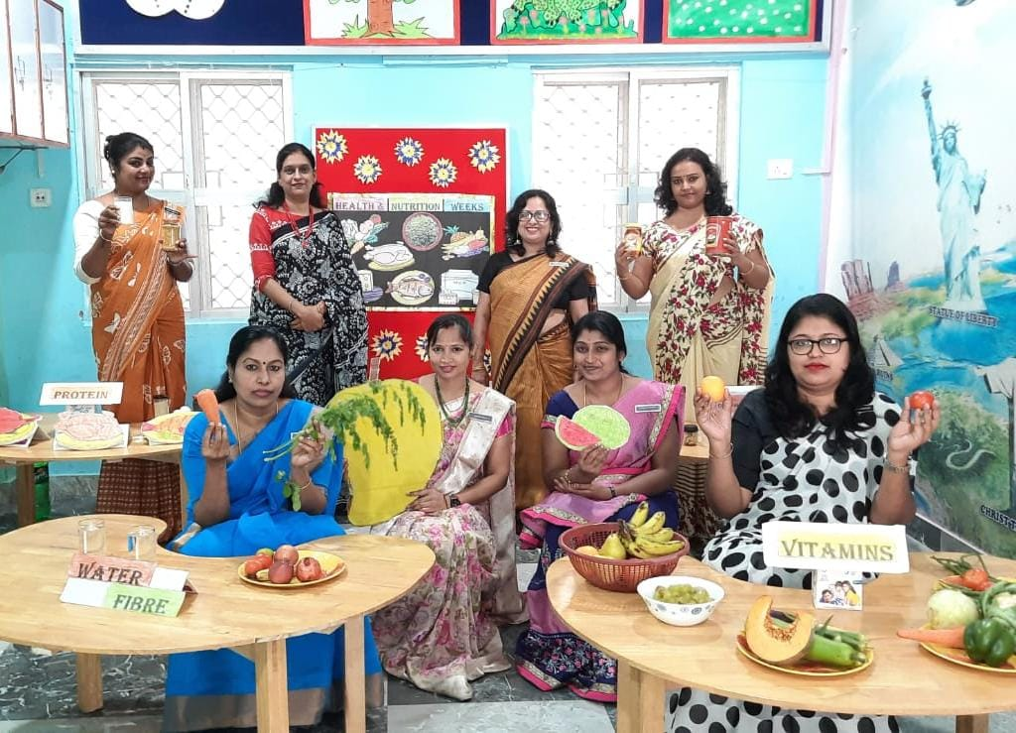
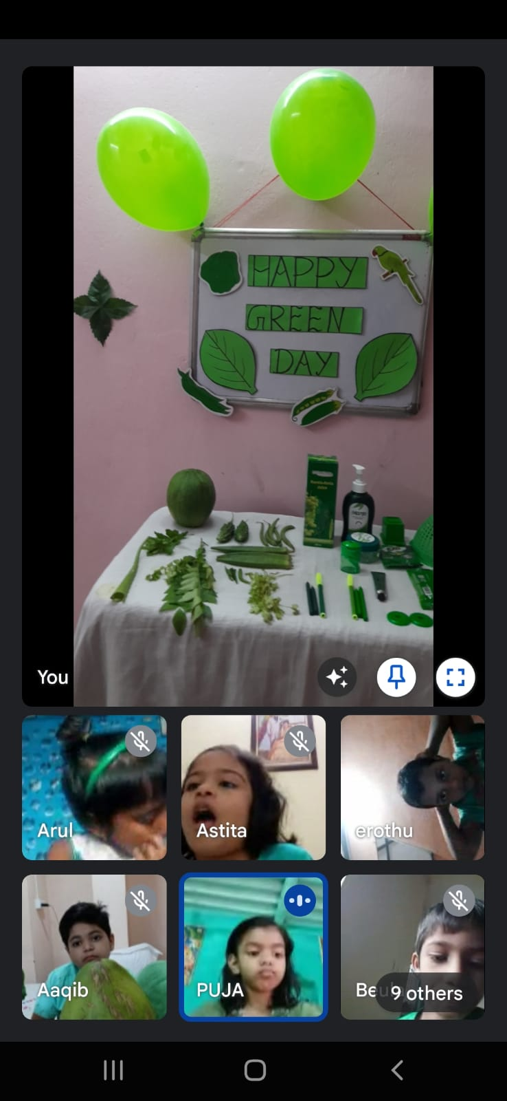
GALLERY
CHILDREN’S DAY
RED DAY- COLOURS WEEK
HEALTH & NUTRITION WEEK
GREEN DAY- COLOURS WEEK

Slide 7
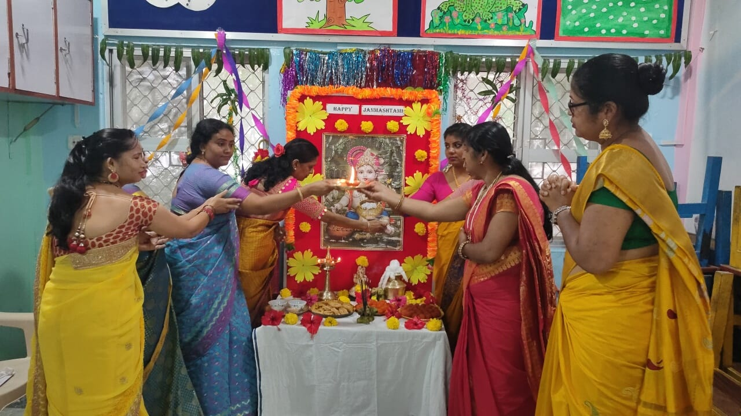
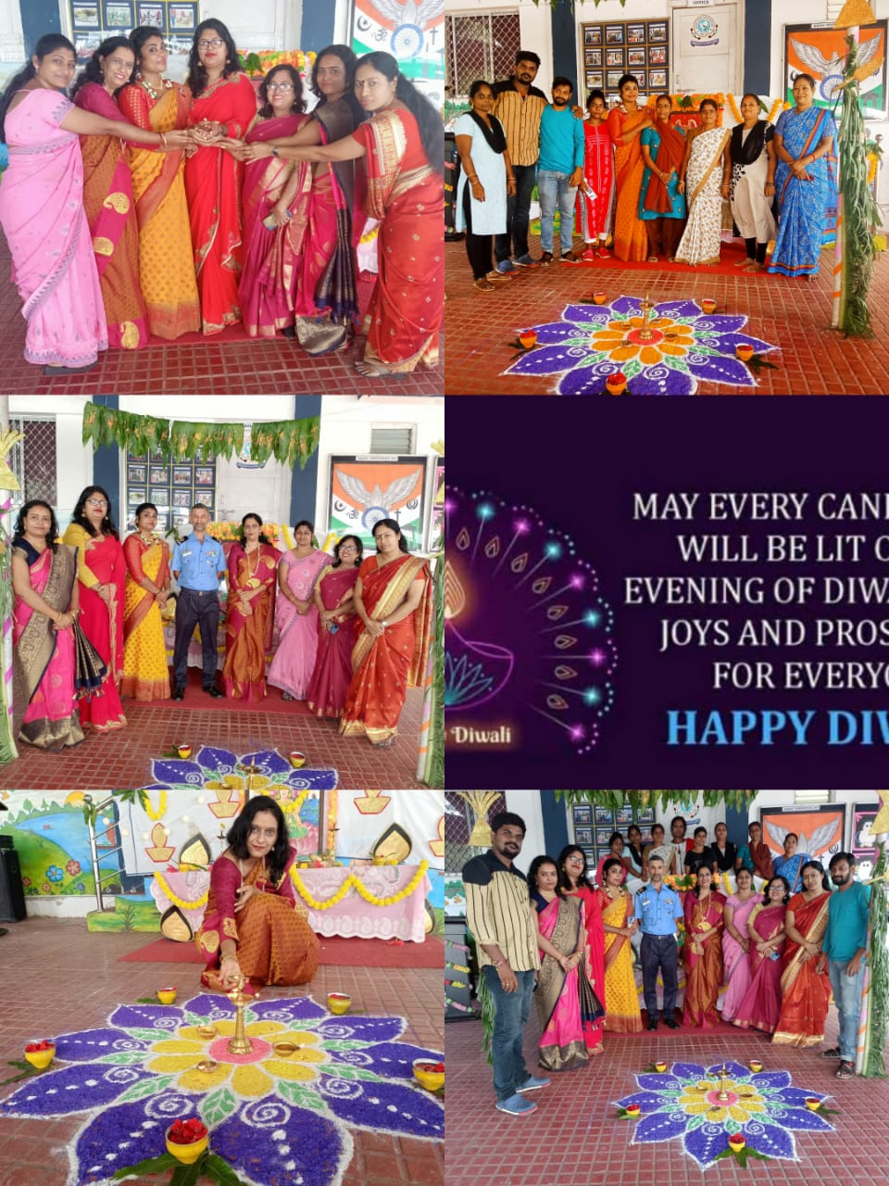
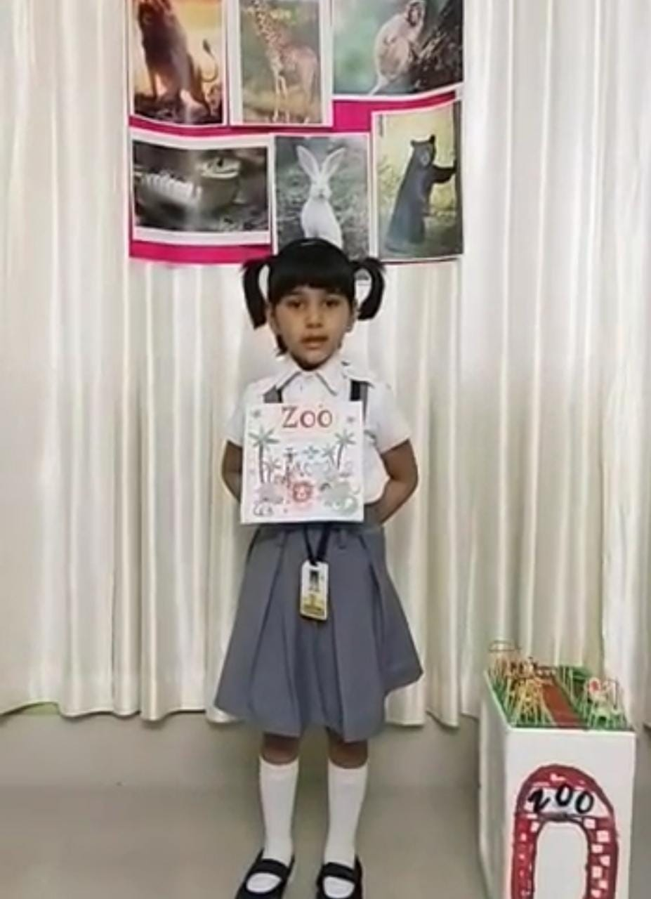
GALLERY
JANMASHTAMI CELEBRATION
RECITATION COMPETITION
DIWALI CELEBRATION

Slide 8
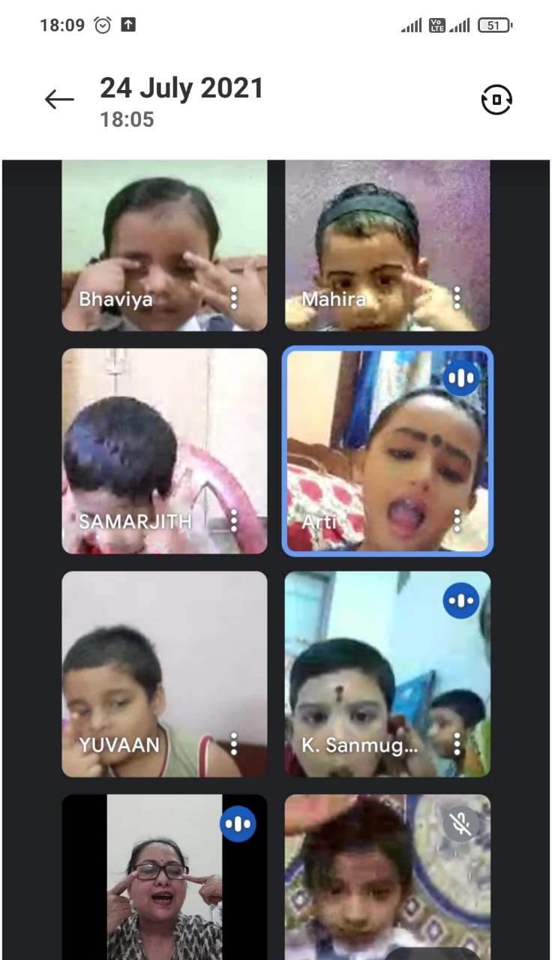
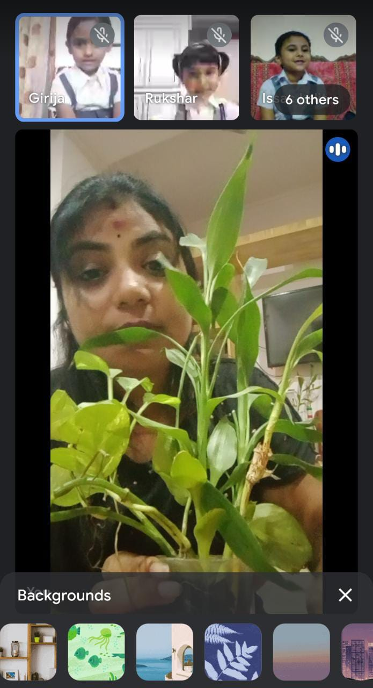
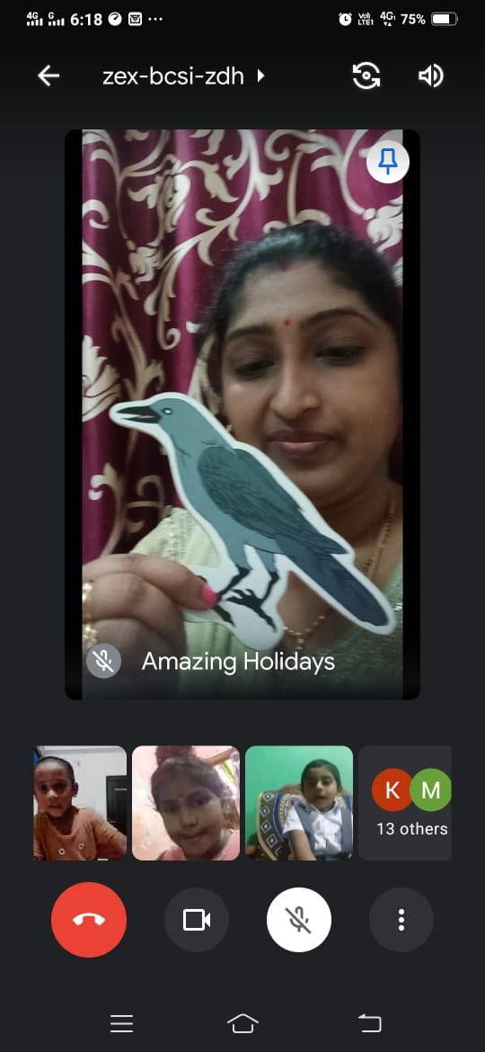
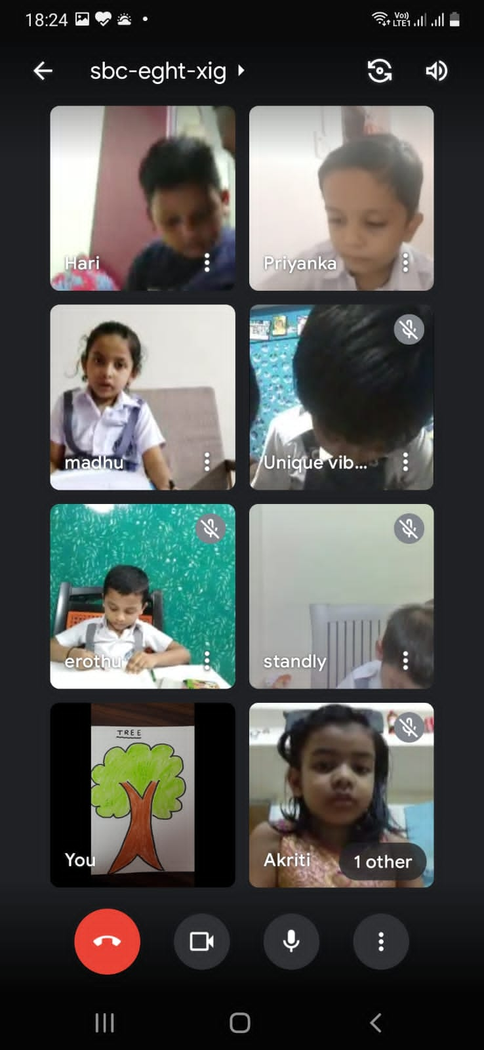
GALLERY
ONLINE CLASSES

